Slide 1

Tutorial on Machine Learning for Time-Series
ODSC 2022, Ben Auffarth

Slide 2
Tutorial on Machine Learning for Time-Series
Part 1 (40 mins): Fundamentals of Machine Learning for Time-Series
Time-Series concepts
Machine Learning landscape
Main models
Python ecosystem
Part 2 (25 mins): Preprocessing Time-Series
Overview
Loading time-series
Plotting
Featurisation
Part 3 (15 mins): Modelling Examples

Slide 3


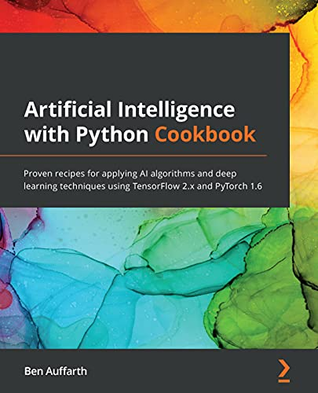

Who am I?
Head of data science at loveholidays
In past life: research and Ph.D. in computational and cognitive neuroscience
Designed and conducted wet lab experiments on cell cultures
Analysed experiments with terabytes of data
Run brain models on IBM supercomputers with up to 64k cores
Work on credit rating, ranking, recommenders, forecasting, NLP, etc
Built production systems processing hundreds of thousands of transactions per day
Trained neural networks on millions of text documents
Authored two books on machine learning
Co-founder and former president of Data Science Speakers, London
Reading lots of stories to my son
Ben Auffarth

Slide 4
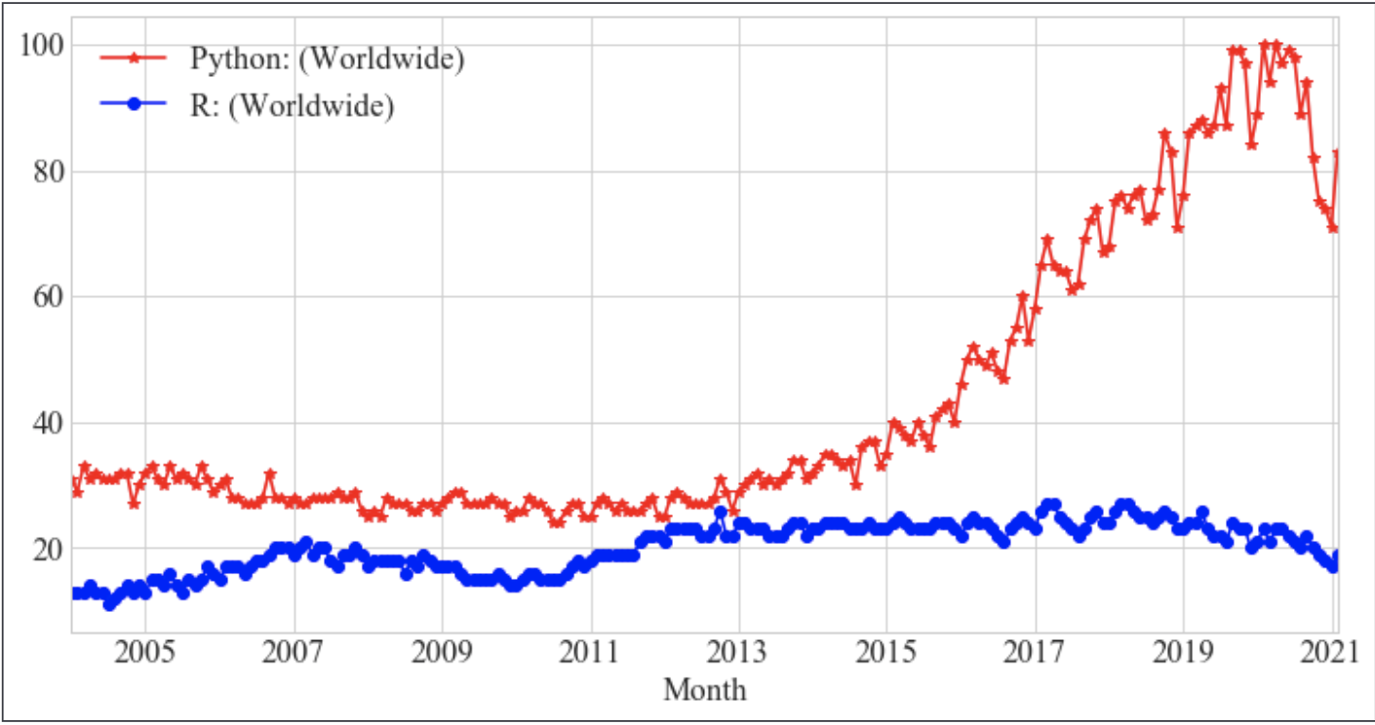
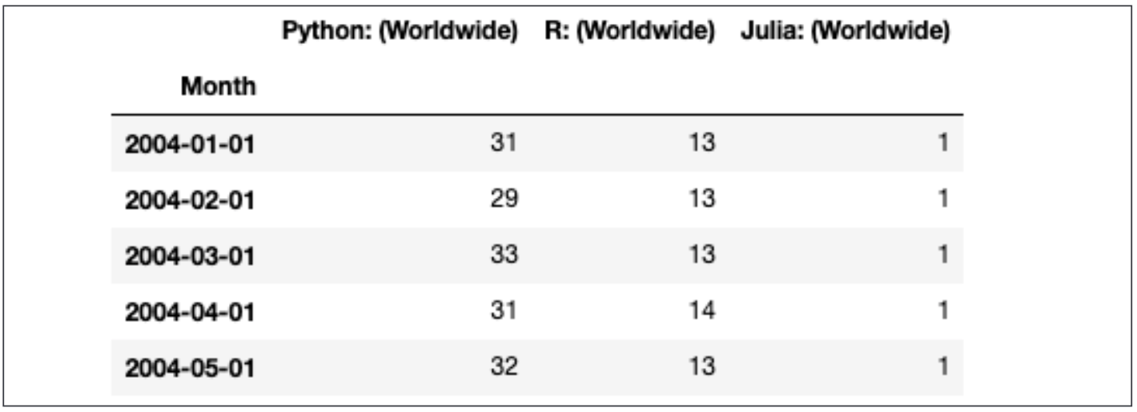
What's a Time-Series?
Numerical data obtained at (regular) time-intervals

Slide 5
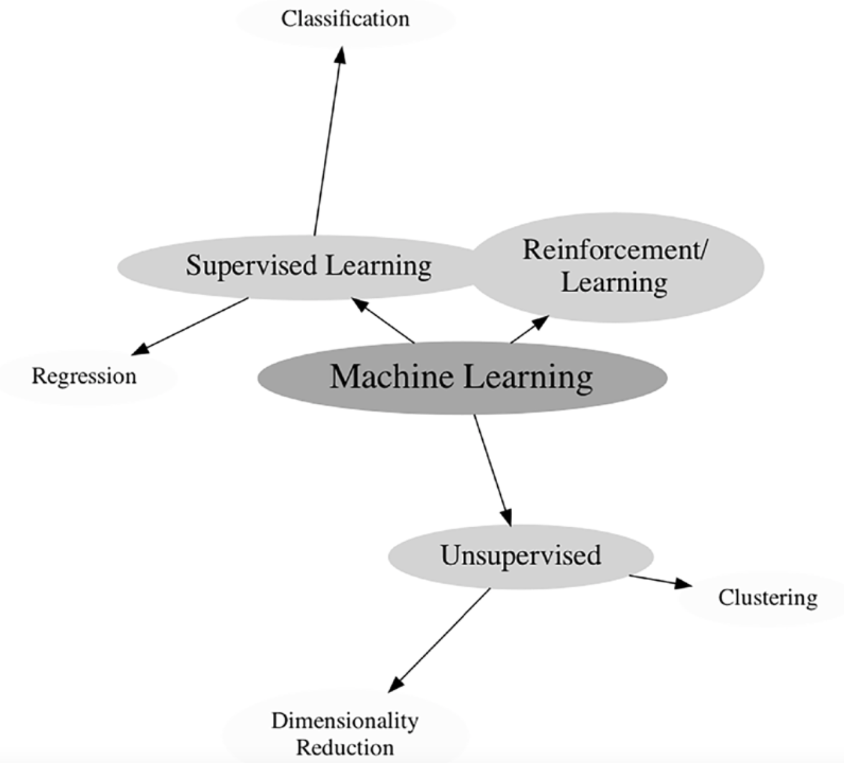
What's a Time-Series?
Time-Series analysis
describe and summarise time-series data
Regression, classification, forecasting
fit models and make forecasts/predictions
Anomaly detection

Slide 6
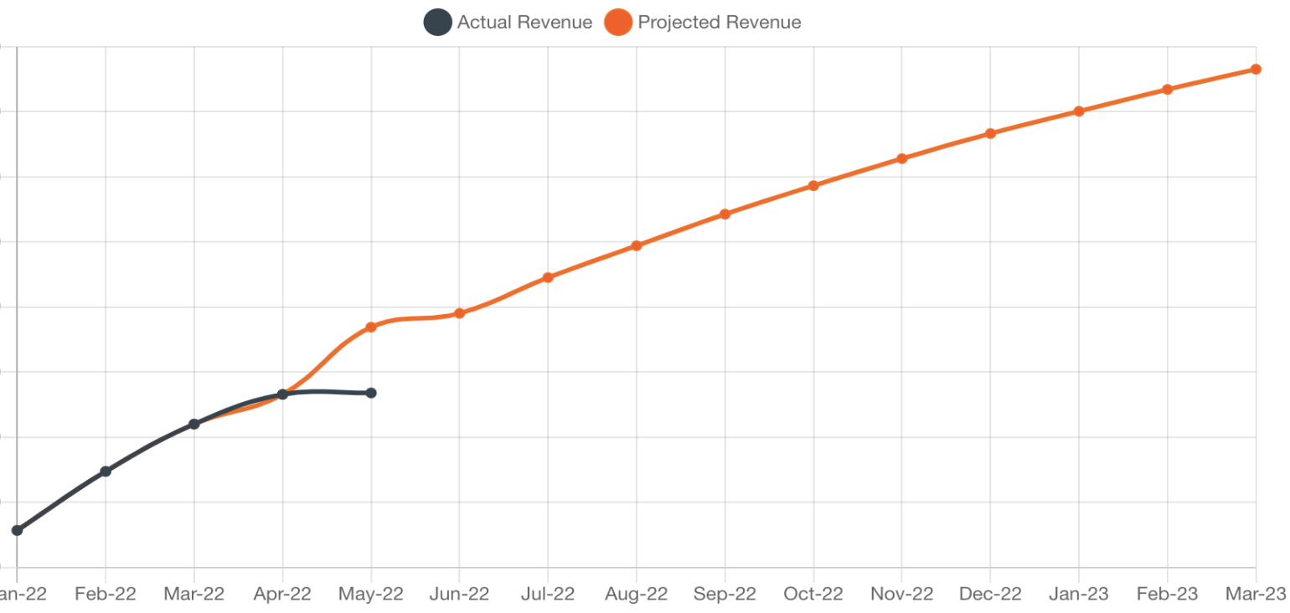
Time-Series Applications (1)
Election forecasts
Sales forecasting
Electricity load
Component failure

Slide 7
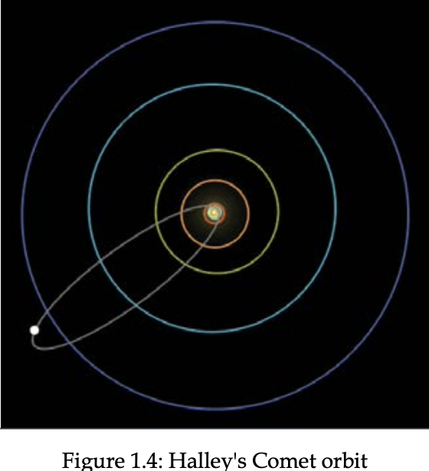
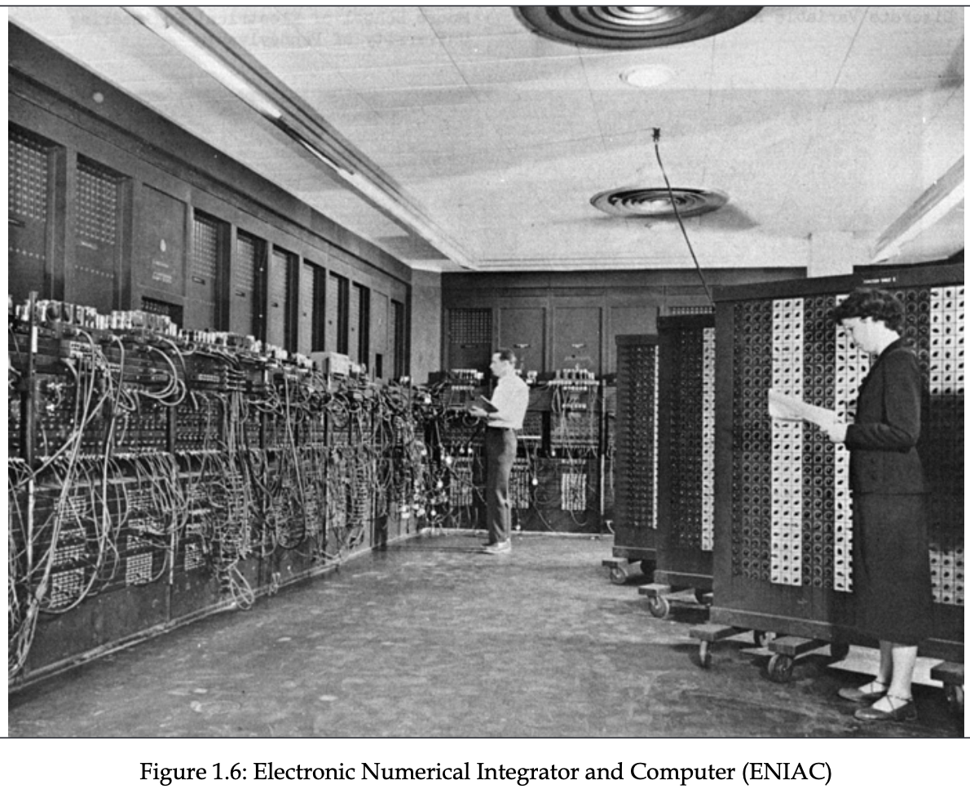
Time-Series Applications (2)
Website traffic
Econometrics
Weather forecast
Astronomy
Trading

Slide 8
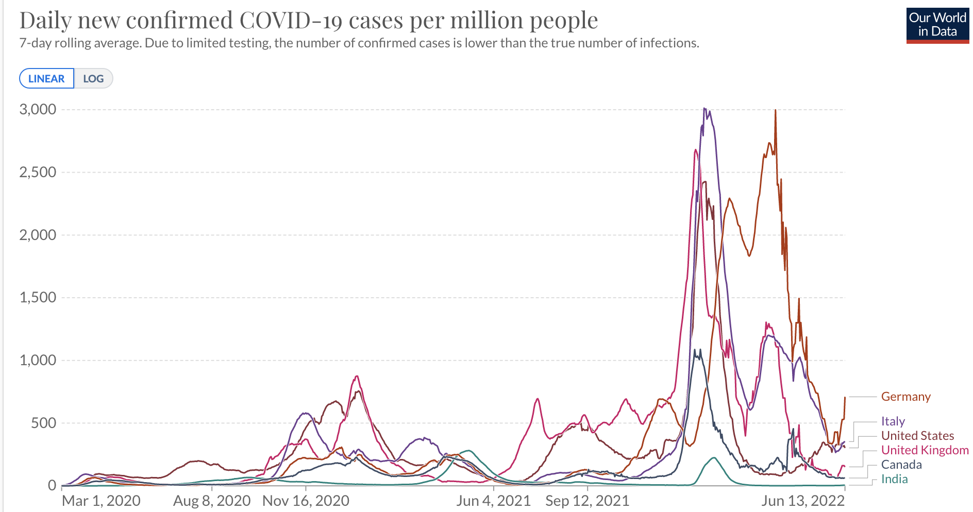
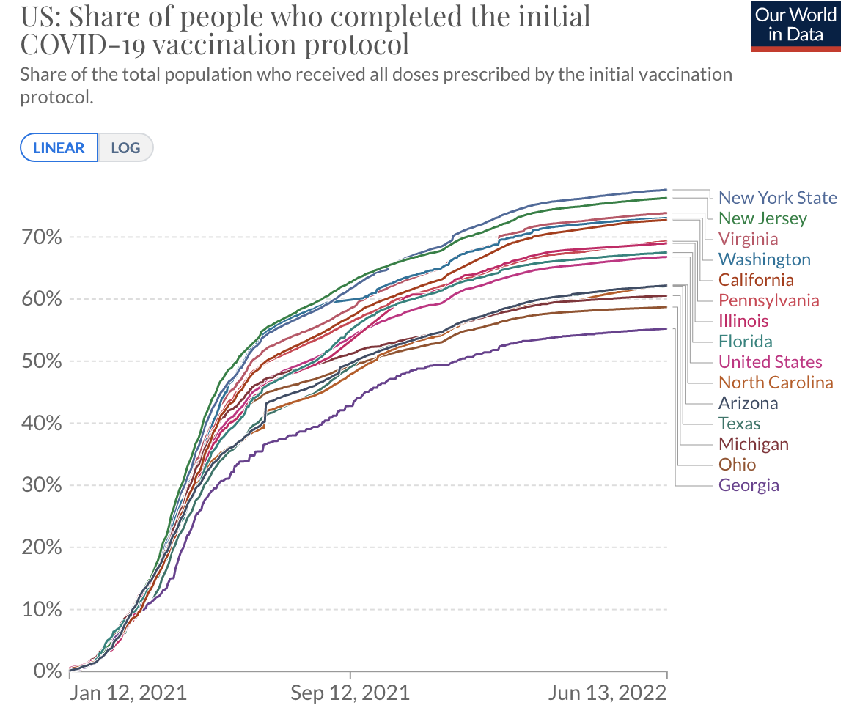
Terminology (1)
Univariate vs multivariate
A univariate time-series has a single time-dependent variable
A multivariate time-series has more than one time-dependent dependent variable
Exogenous features
time-dependent predictor variables
Forecasting, classification, regression

Slide 9
Terminology (2)
Stationarity
The variance and the mean of the data are constant; covariance is not a function of time
Linearity
Assumptions:
Linear relation between predictor variable and targets (linearity)
Observations are independent of each other (colinearity)
Trend
Persistent, long-term movement
Seasonality
periodic pattern
usually within 12-month period (day, week, month)

Slide 10
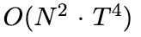
Some algorithms
Type | UTSC | MTSC
Distance-based | DTW | DTW-D
Shapelets | Shapelet Transform | MrSEQL
Symbolic | SAX-VSM, BOSS, WEASEL | WEASEL-MUSE
Ensemble | EE, COTE, HIVE-COTE, TS-CHIEF | ROCKET
Deep Learning | ResNet, FCN | TapNet
COTE (Collective Of Transformation-based Ensembles
Ensemble of 35 classifiers
Univariate
HIVE-COTE
Extension of COTE with hierarchical structure and probabilistic voting
hugely computationally intensive
ROCKET

Slide 11
HIVE-COTE
1.0:
Shapelet Transform Classifier (STC)
Time-Series Forest
Contract Bag of Symbolic-Fourier Approximation Symbols (cBOSS)
Random Interval Spectral Ensemble (c-RISE)
More improvements coming:
Temporal Dictionary Ensemble (TDE, 2021)
Canonical Interval Forest (CIF)

Slide 12
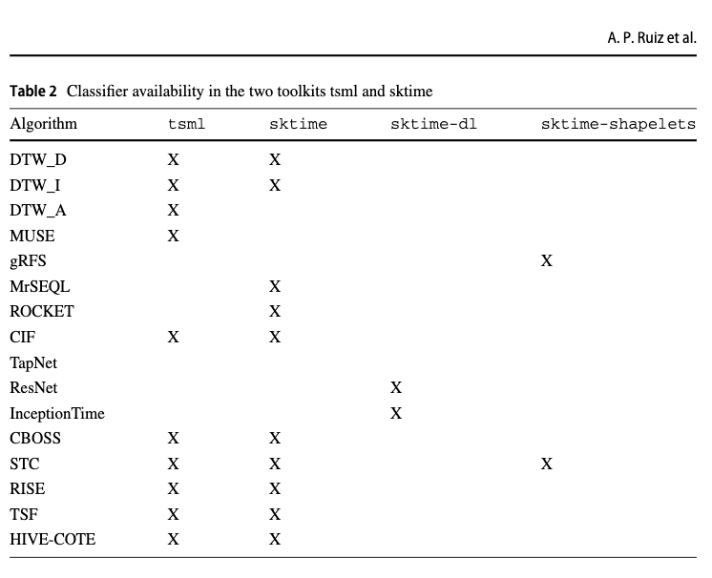
Implementations
Sktime
Pyts
Other
https://github.com/hfawaz
https://github.com/angus924/minirocket

Slide 13
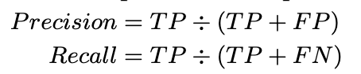
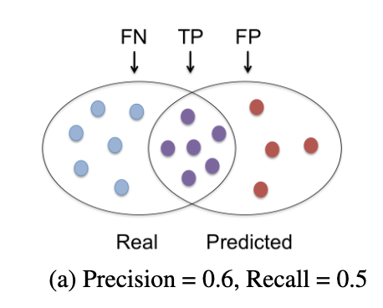
Measures for time-series
Error metrics
Regression
R2 explained variance sklearn metrics
Product-moment correlation, Spearman correlation
Tweedie deviance
Classification
Precision
Recall
Fβ-Score, where β represents the relative importance of Recall to Precision
F1 statistics
receiver operator curve (AUROC),
balanced accuracy
Time-Series comparisons

Slide 14
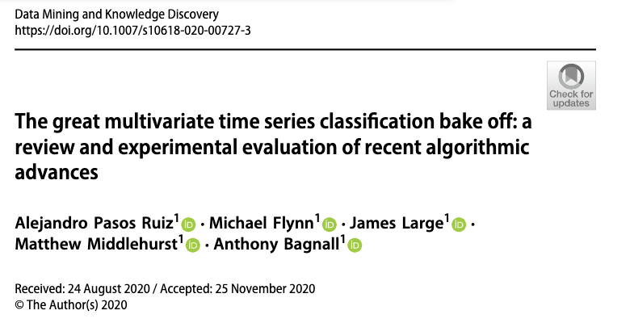
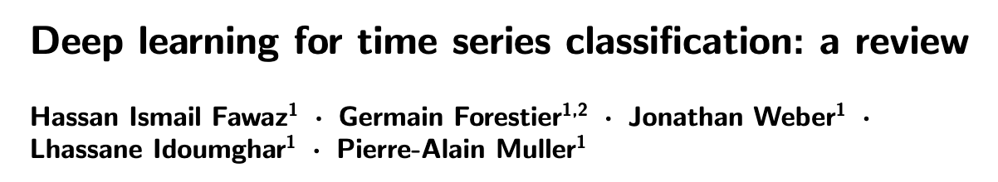
Multivariate Time-Series

Slide 15
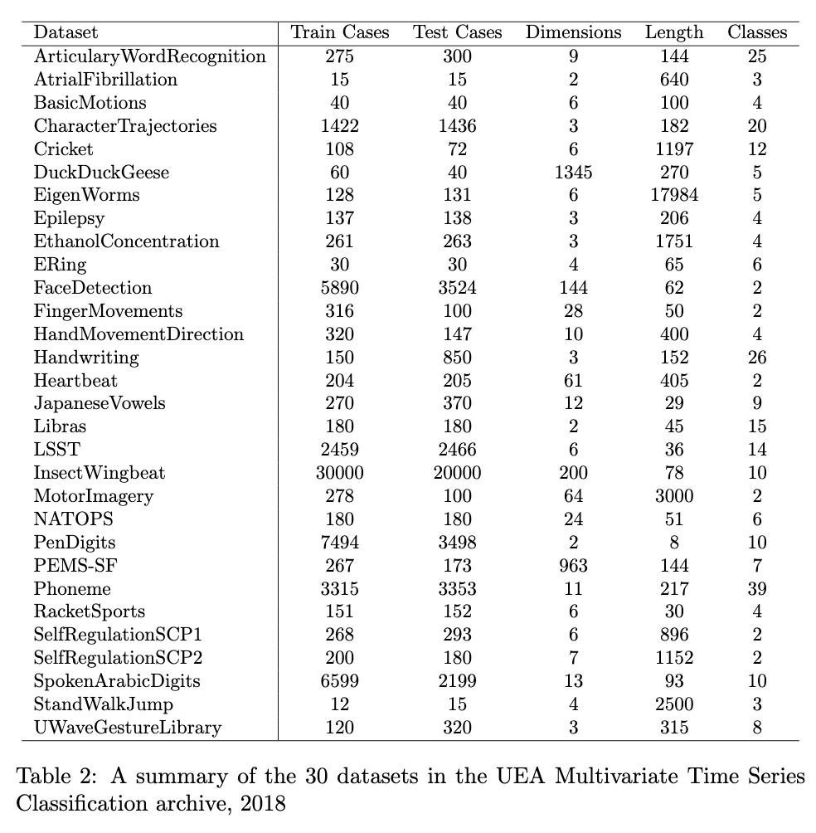
Benchmarks for Time-Series
Classification vs regression
Unsupervised vs supervised
Univariate
Each case has a single series and a class label
Emphasis of earlier models (classical modelling)
UCR archive: about 120 datasets
Multivariate
time series for a single case has multiple dimensions
Formally k>1
More frequent in practice
UAE archive: 30 datasets
MTS archive: 13 datasets.

Slide 16
The great multivariate time series classification bake off
Review/Survey paper: Pasos Ruiz et al 2020
multivariate TSC
26 datasets from UAE archive
Distance-based approaches
Dynamic time warping, independent warping, adaptive warping
MUSE, ...

Slide 17
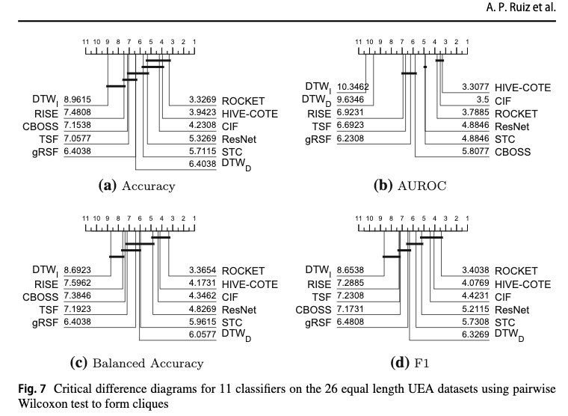
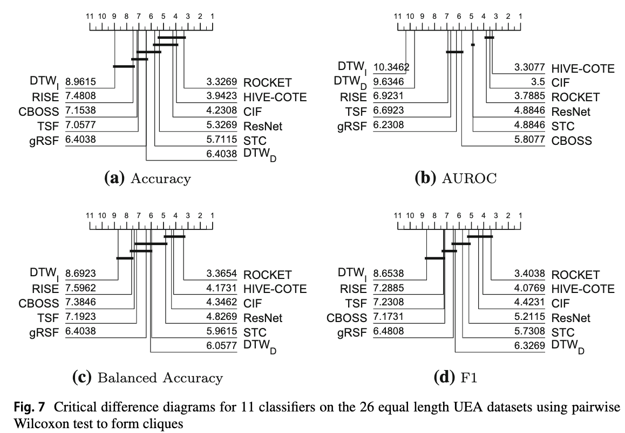
Results (1)
Not all finished
Comparison of sixteen classifiers on twenty datasets
Critical difference diagrams
ROCKET achieves considerable improvement in at least an order of magnitude less time

Slide 18
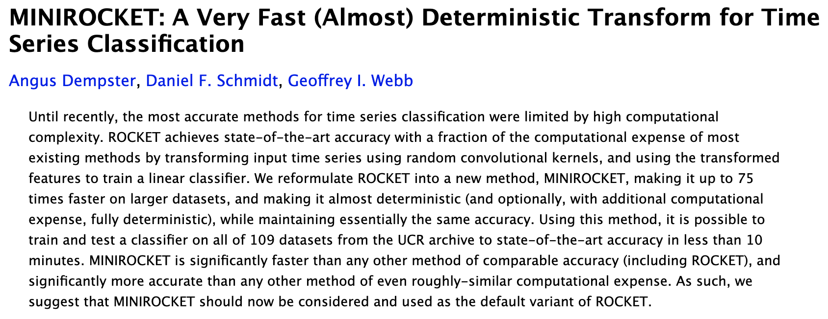
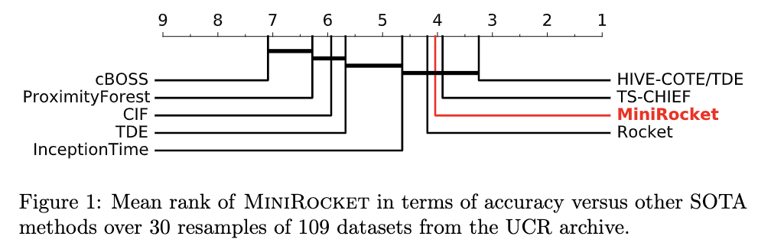
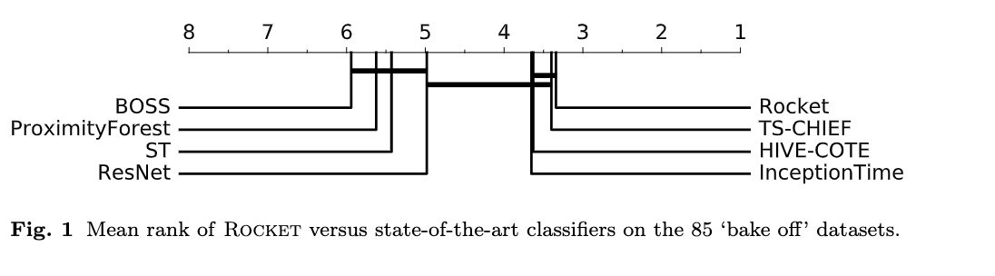
ROCKET
MINIROCKET (Dempster et al 2020)
up to 75x faster on big datasets while maintaining the same accuracy

Slide 19
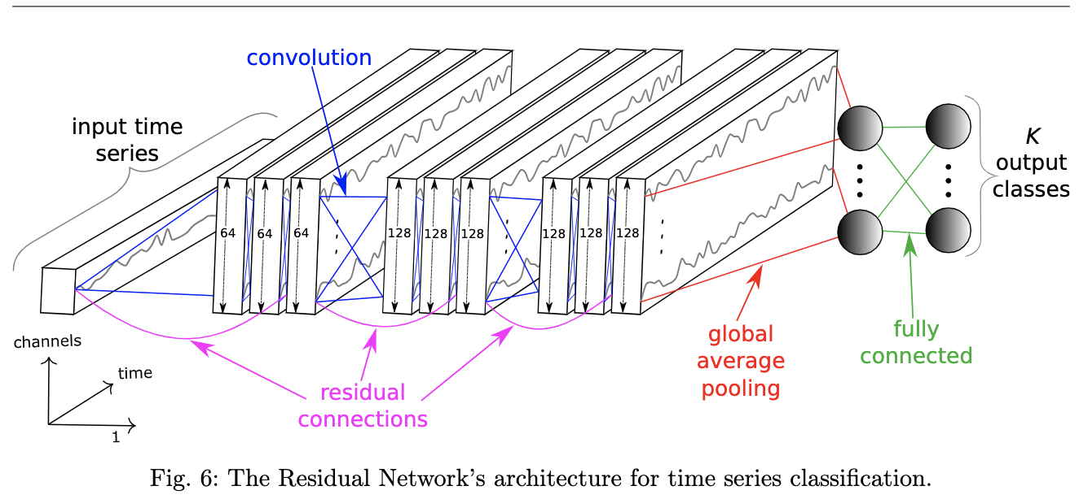
Deep Learning for Time-Series
Review/Survey paper: Fawaz and others 2019
Companion repo
tensorflow/keras
On the univariate UCR/UEA time series classification archive (85 problems)
11 classifiers:
LeNet, FCN, Time-CNN, ResNet,
cluster of 60 GPUs
results in about a month

Slide 20
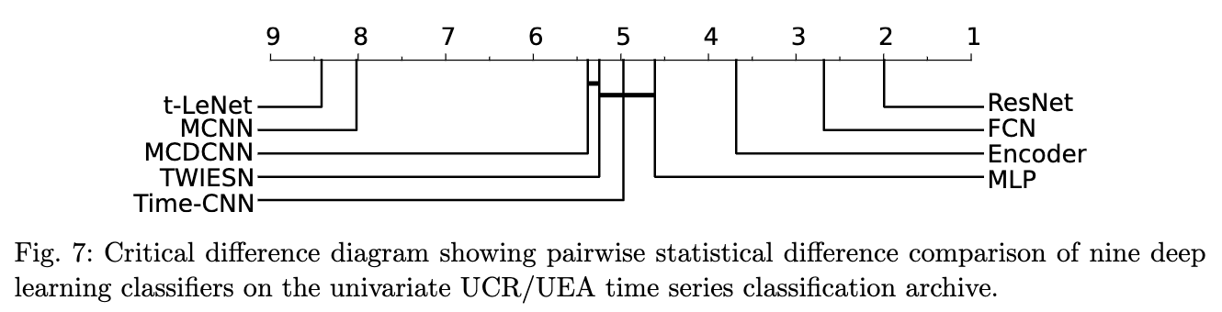
Results (1)
Comparison
9 completed all tests
ResNet wins on 50 problems out of 85

Slide 21
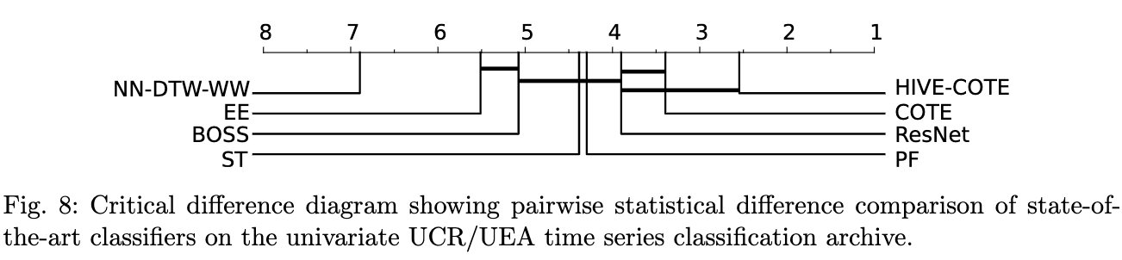
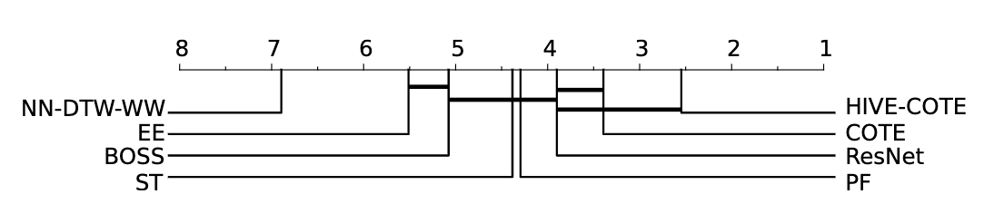
Results (2) - Comparison to SOTA approaches
Most worse performance to SOTA
ResNet not significantly worse

Slide 22
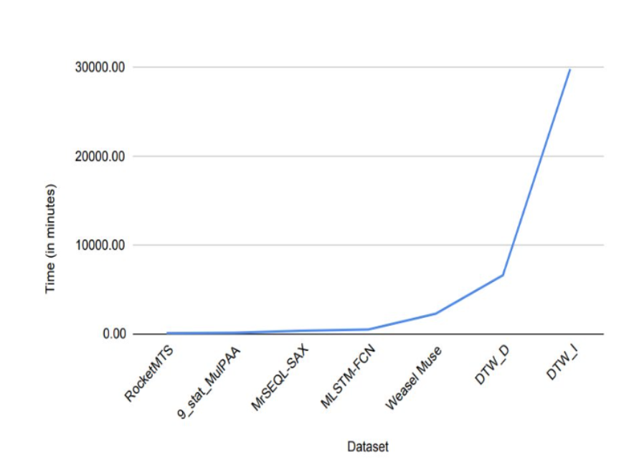
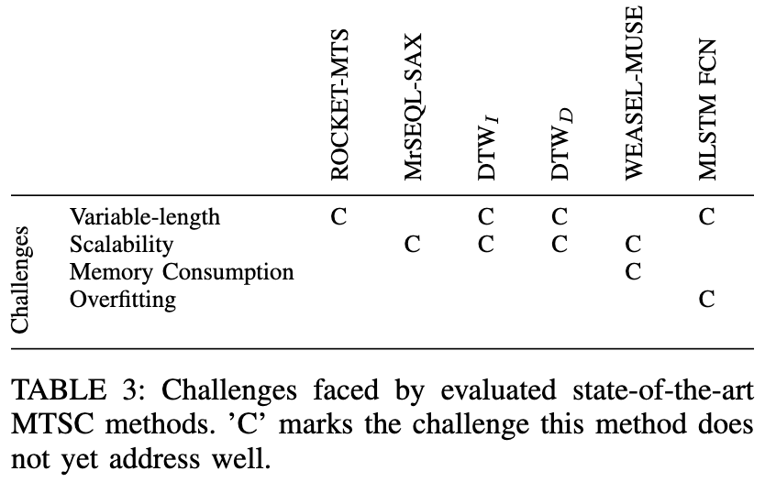
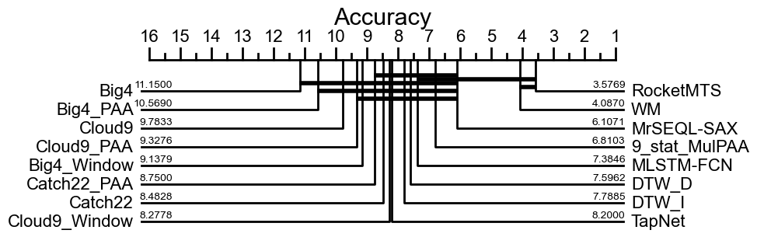
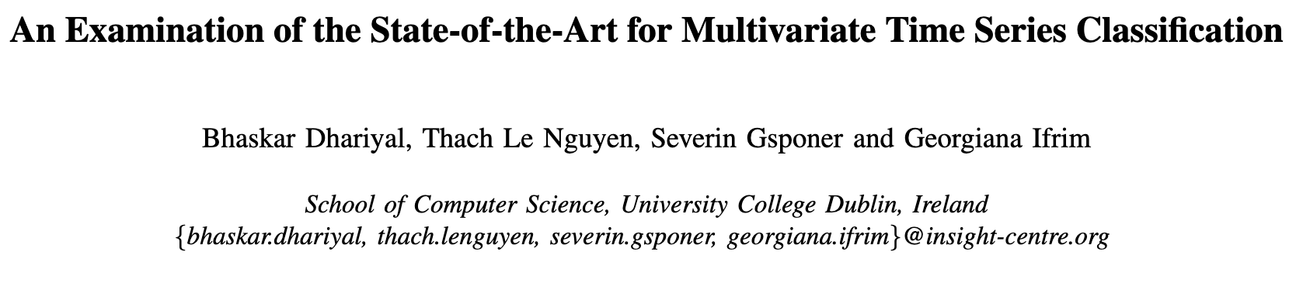
Inter-dimension Dependency
Dhariyal et al 2020
20 datasets
Accuracy: ROCKET wins, deep learning not that good
Runtime: ROCKET: 34 minutes, DTW runs for days

Slide 23
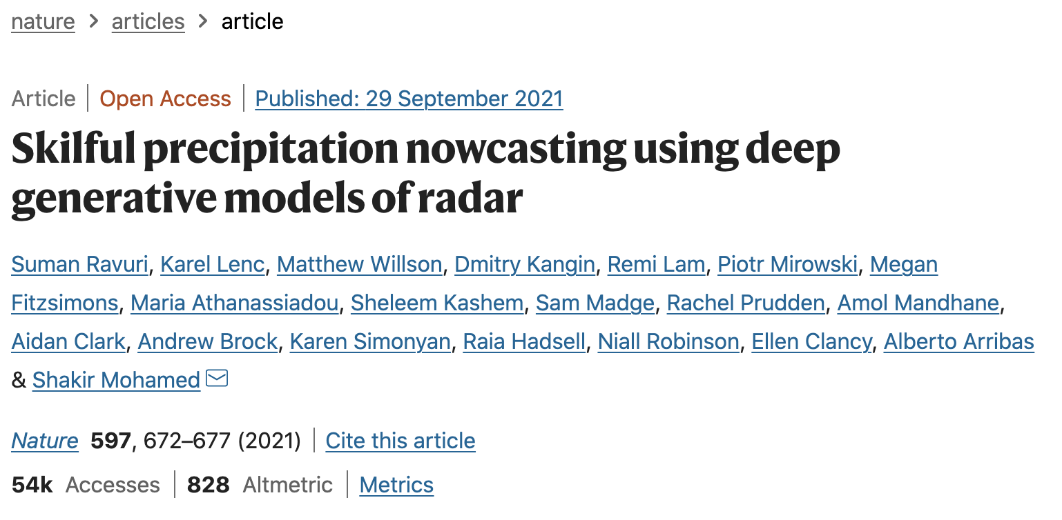
Deep generative model for the probabilistic nowcasting of precipitation from radar
Architecture blocks:
feed-forward convolutional neural network (conditioning stack)
ConvGRU (sampler)
Normal, Convolutions (latent conditioning stack)

Slide 24
Preprocessing

Slide 25
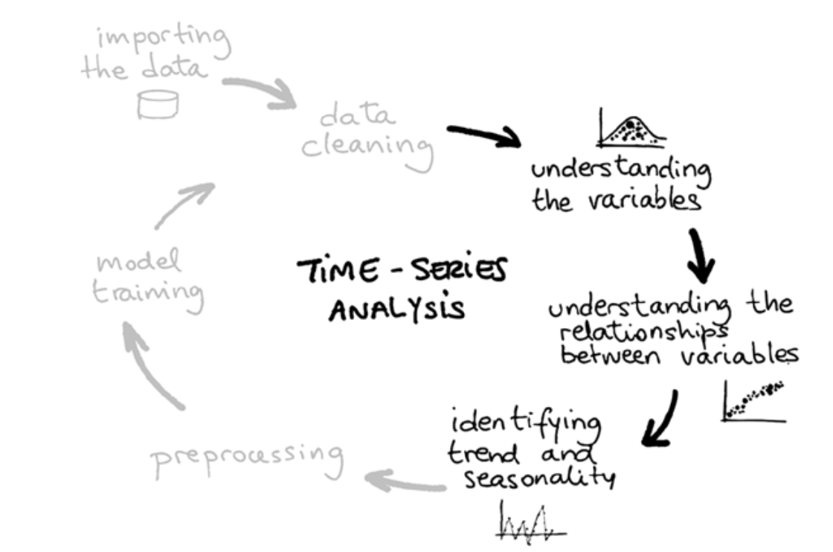
Time-Series Analysis

Slide 26
Preprocessing
Transforms
Scaling
Power/log transforms
Imputation
Decomposition
Feature engineering

Slide 27
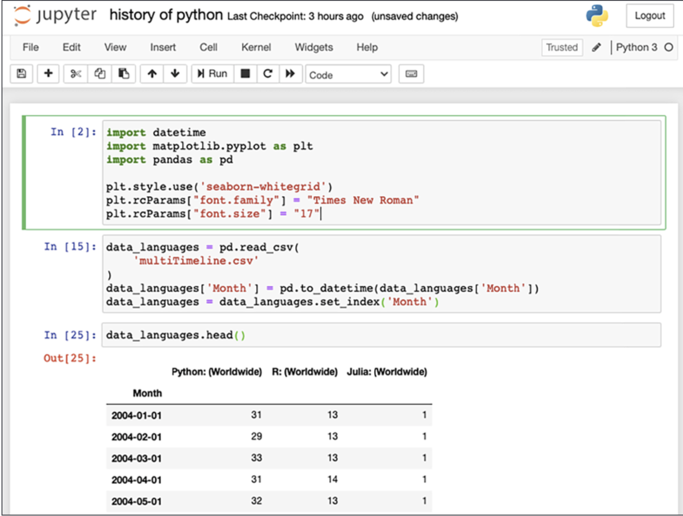
Loading a Time-Series

Slide 28
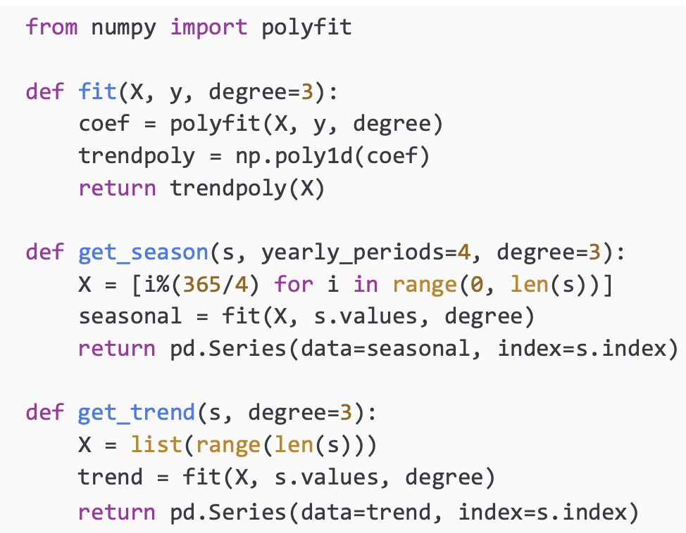
Decomposition (1)

Slide 29
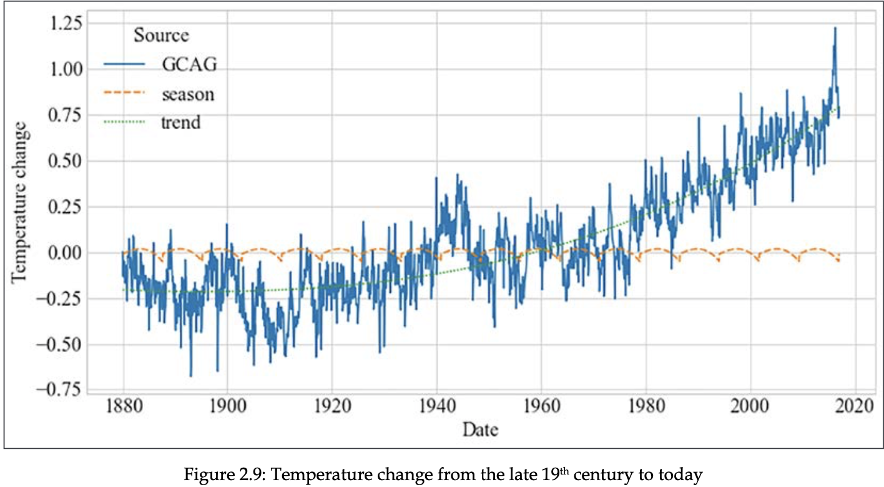
Decomposition (2)

Slide 30
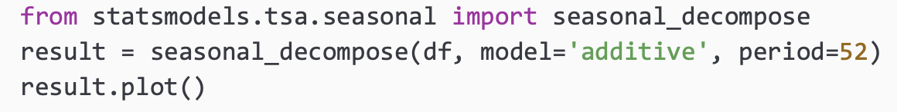
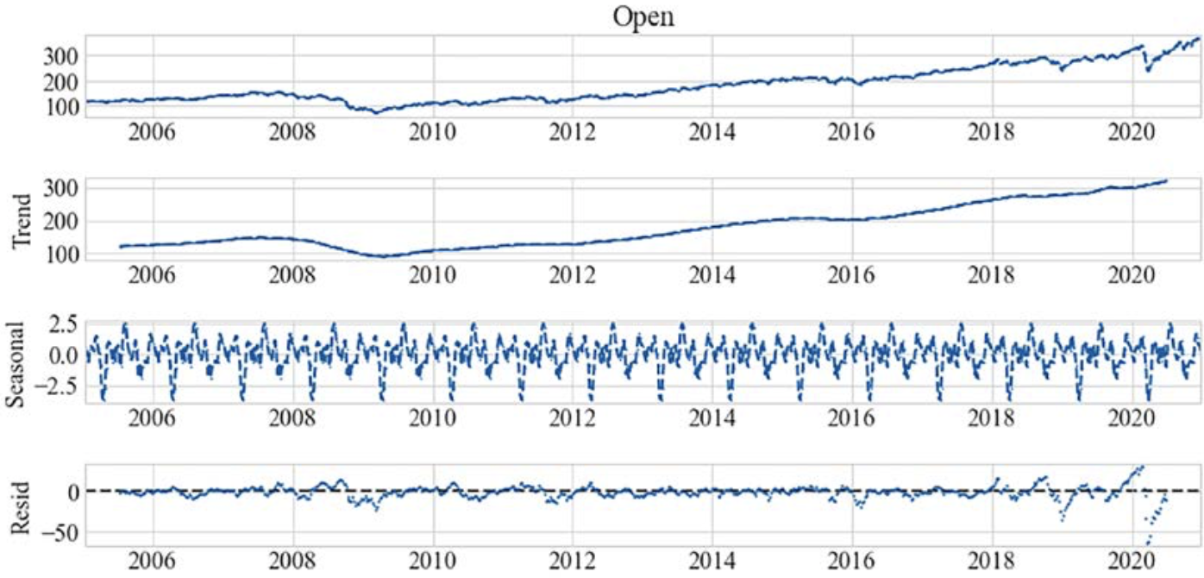
Decomposition (3)

Slide 31
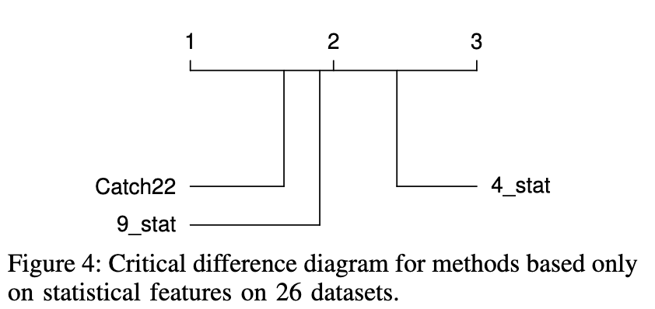
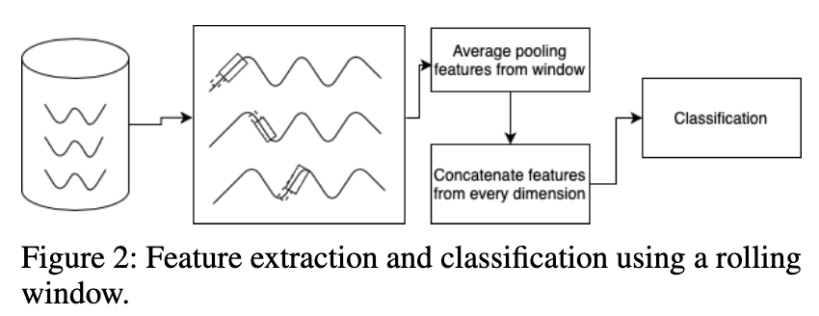
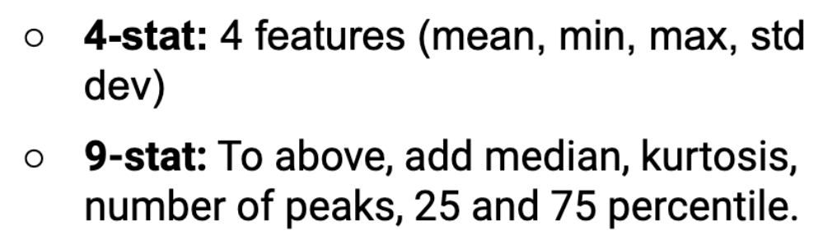
Feature engineering (1) - hand-crafted features
Machine learning algorithms can use different representations of the input features (preprocessing/feature engineering)
Hand-crafted vs automated feature extraction
Interpretable: mean, max, min, etc
Pooled within windows
Catch22
features and simple summary statistics extracted from phase dependant intervals
Reduced set from Highly Comparative Time Series Analysis (hctsa) toolbox
Calendar features
trade-off between accuracy and prediction times
Huge differences in time complexity and model performance

Slide 32
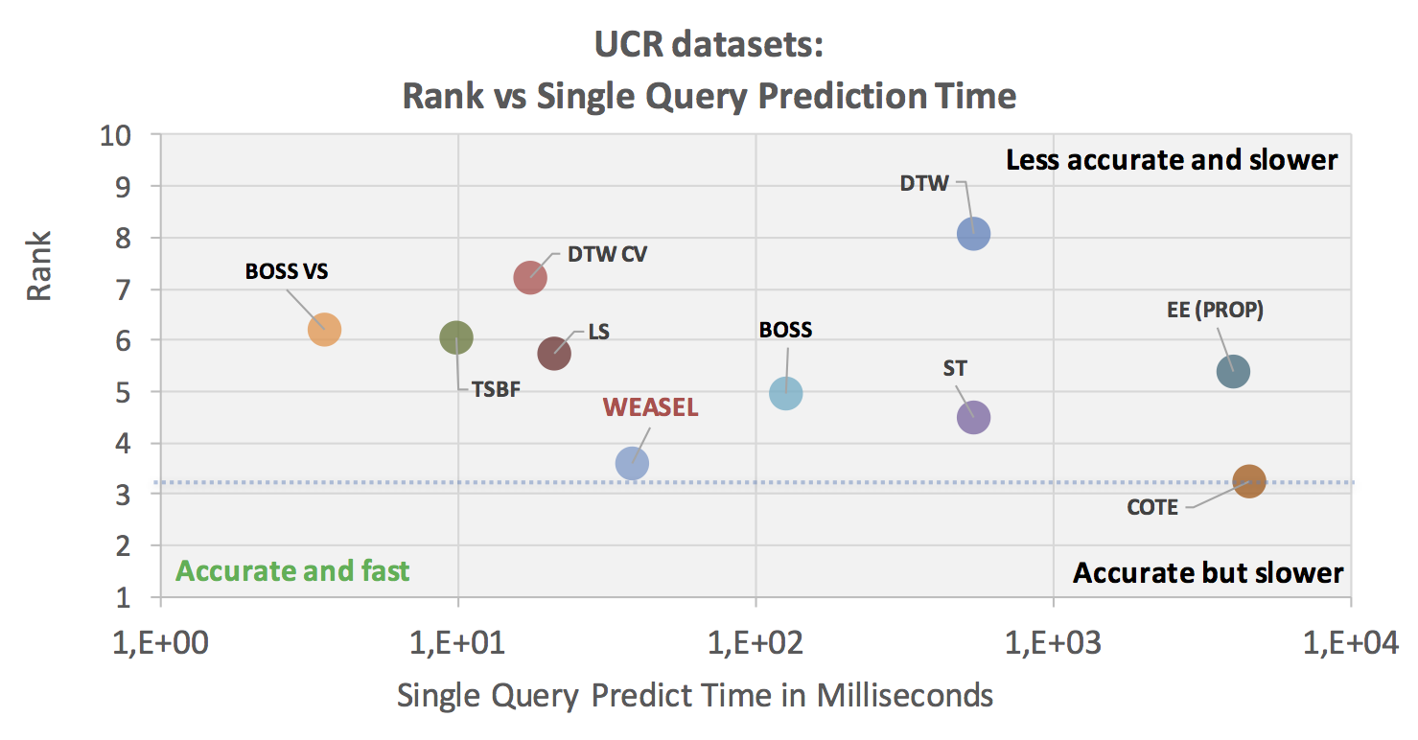
Feature engineering (2)
Non-Interpretable
SIFT features
scale-invariant features
shapes surrounding the extremum (Bailly and others, 2015)
Shapelets (Ye and Keogh 2011)
ROCKET
MINIROCKET
BOSS
histograms of n-grams to form bag-of-patterns (BoP)
BOSS in Vector Space (BOSS VS)
WEASEL+MUSE
Word Extraction for Time Series Classification
Multivariate Unsupervised Symbols and Derivatives

Slide 33
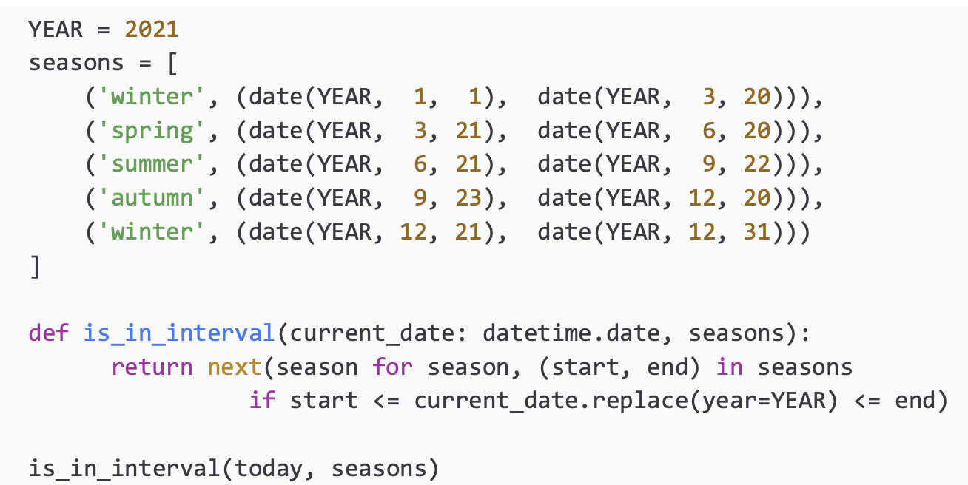
Calendar features (1)

Slide 34
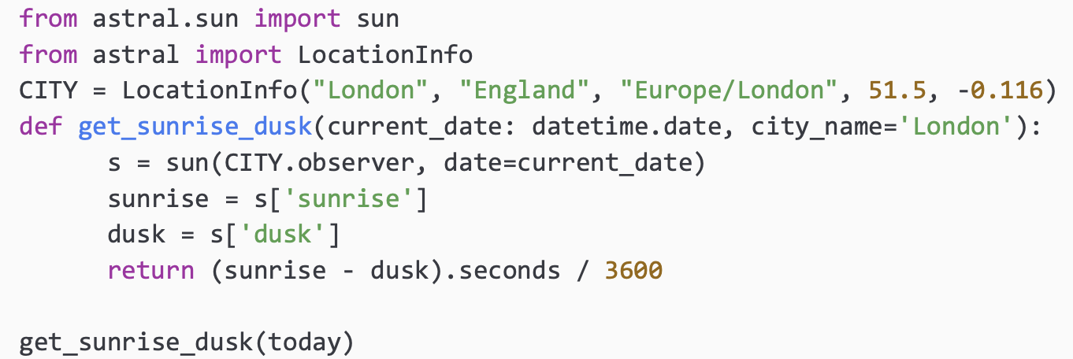
Calendar (2)

Slide 35
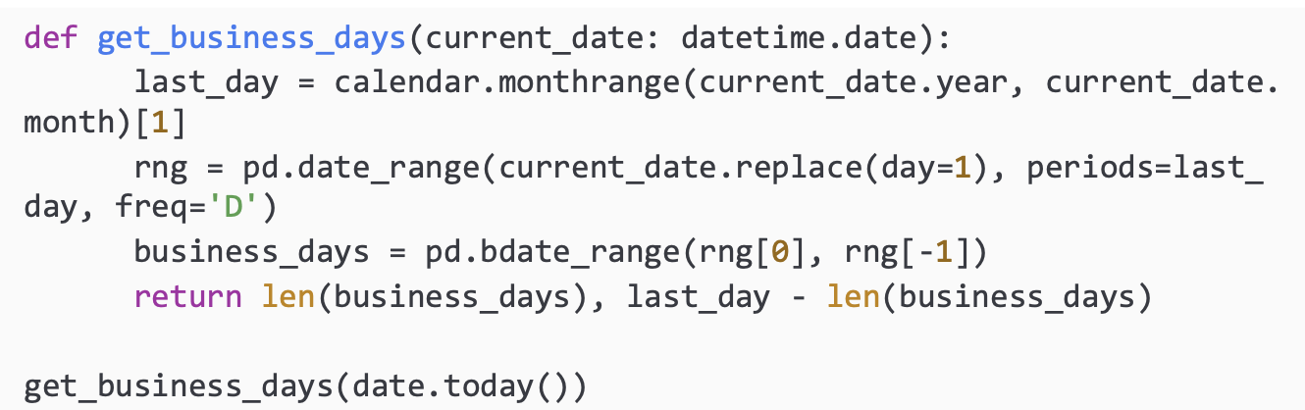
Calendar (3)

Slide 36
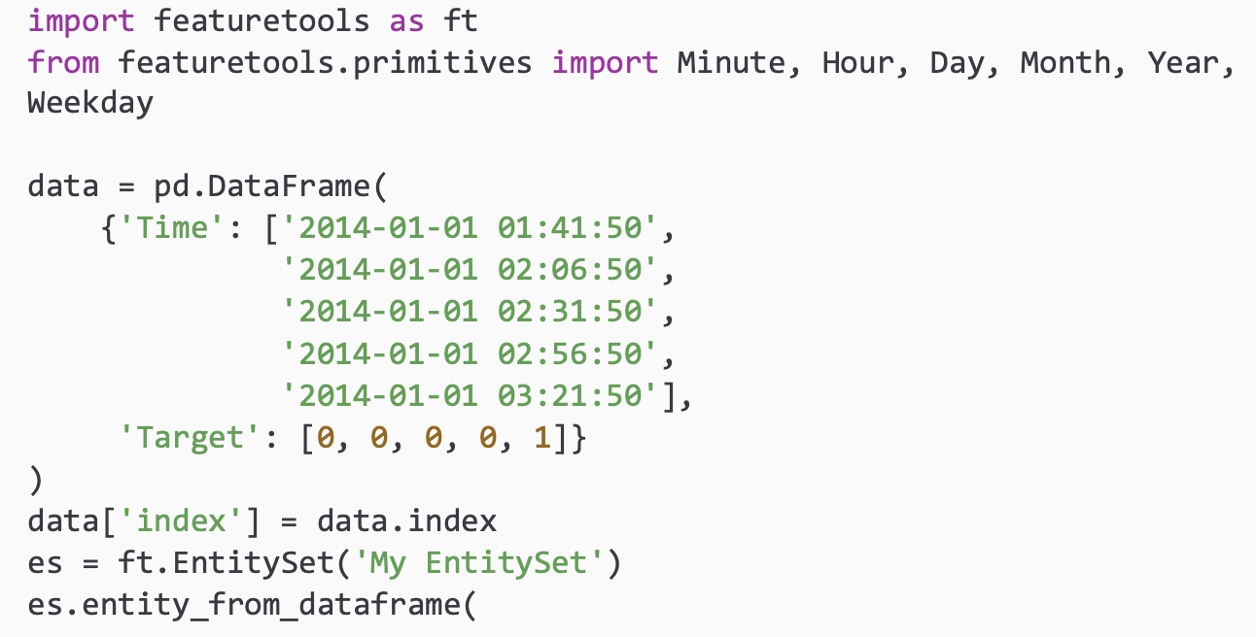
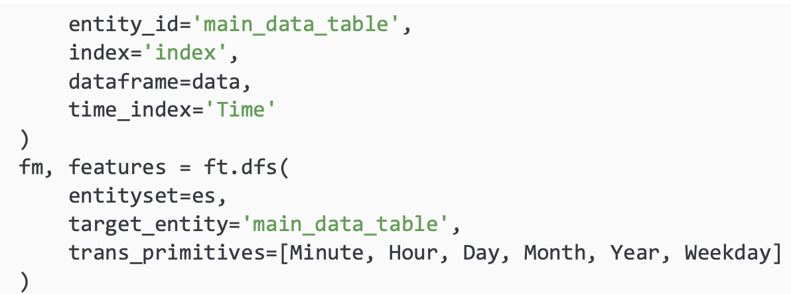
Automated Feature Extraction

Slide 37
Modelling Examples

Slide 38
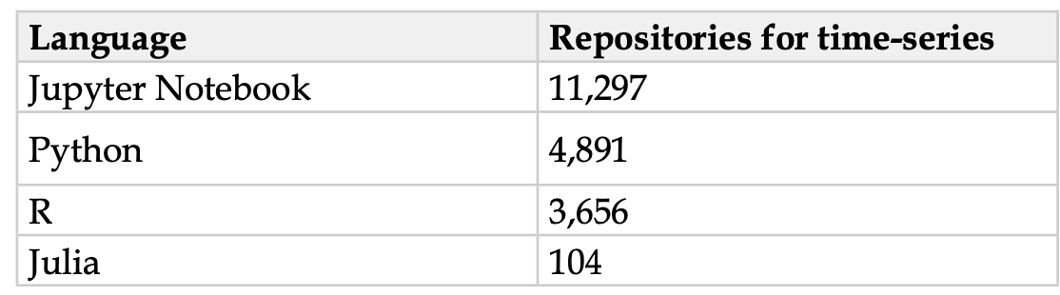
Python libraries for time-series
statsmodels
prophet
sktime
gluon-ts
tslearn
pyts
seglearn
darts
cesium
pmdarima

Slide 39
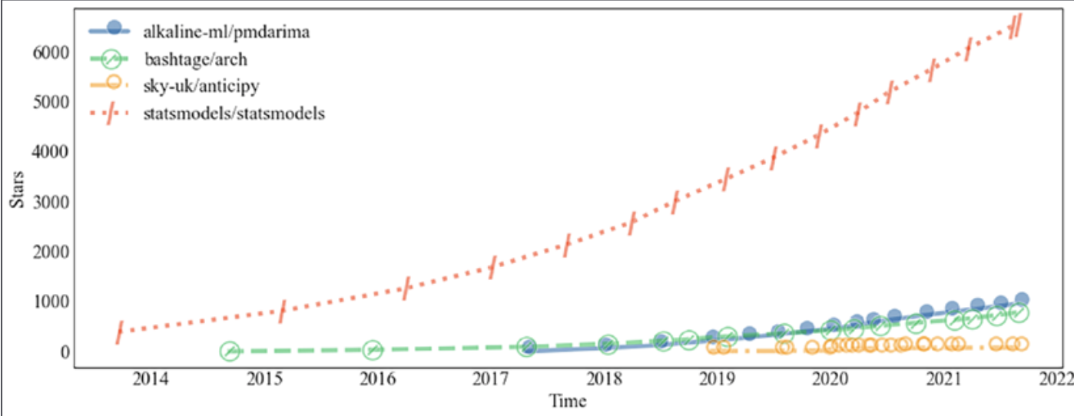
Python libraries with classical models

Slide 40
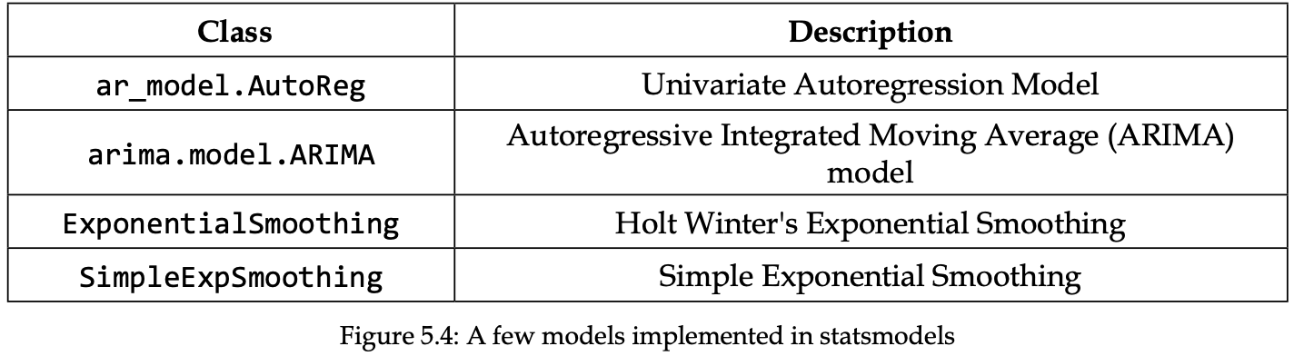
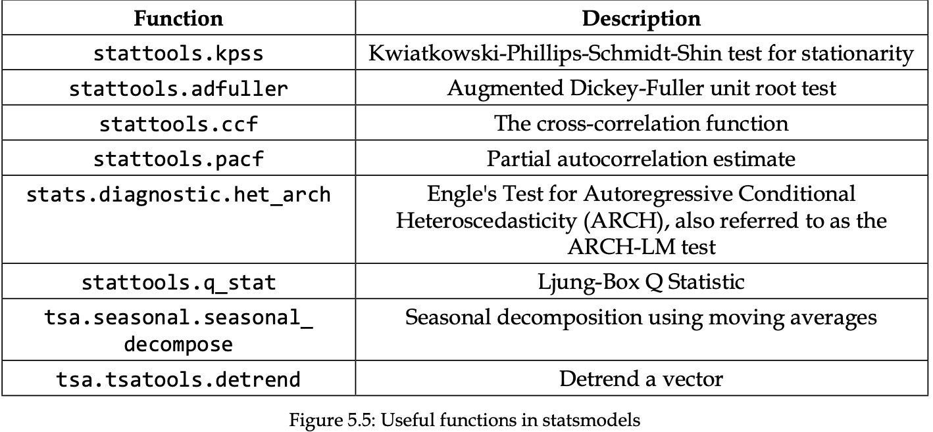
Statsmodels

Slide 41
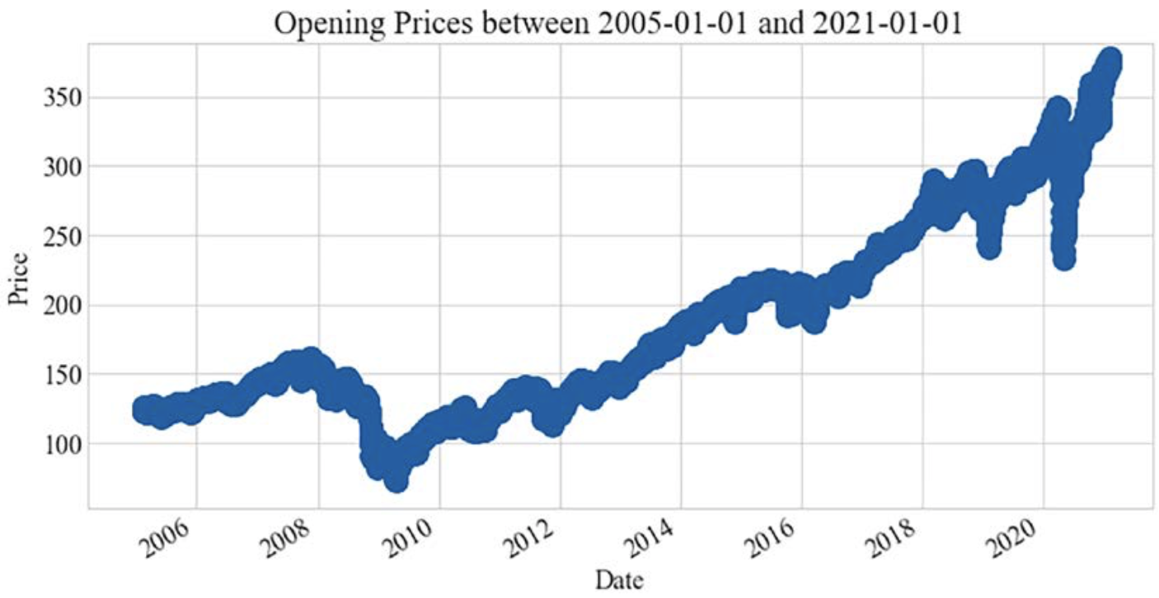


Example with classical models (1)

Slide 42


Example with classical models (2)

Slide 43
Models
 | Exogenous variables | Multivariate | Training Speed | Complexity | Probabilistic
Generalized Linear Model | Yes | No | Fast | Low | No
Exponential Smoothing | No | No | Fast | Low | No
UnobservedComponents | Yes | No | Fast | Low | Yes
ARIMA | Yes | No | Slow | Low | No
VARMAX | Yes | Yes | Fast | Low | Yes
Theta | No | No | Medium | Low | Yes
lightgbm | Yes | Yes | Slow | Medium | No
LSTM | Yes | Yes | Slow | High | No
Transformer | Yes | Yes | Slow | High | No
CNN | Yes | Yes | Slow | High | No
Stationarity can be enforced

Slide 44


Regression as Forecasting
use established ml techniques to capture relationships
f(exogenous, lagged endogenous) = forecast of endogenous variables

Slide 45


Deep Learning (1)
https://github.com/benman1/time-series

Slide 46



Deep Learning (2)
https://github.com/benman1/time-series

